Slide 1


إيذاء الاخرين لفظيآ
Cyberbullying Detection
By:
John Hani
Mohamed Nashaat
Mostafa Ahmed
Zeyad Emad (Team Leader)
Under supervision of :
Dr. Ammar Mohamed
Dr. Eslam Amer
Eng. Menna Gamil
Date:4\2\2019

Slide 2

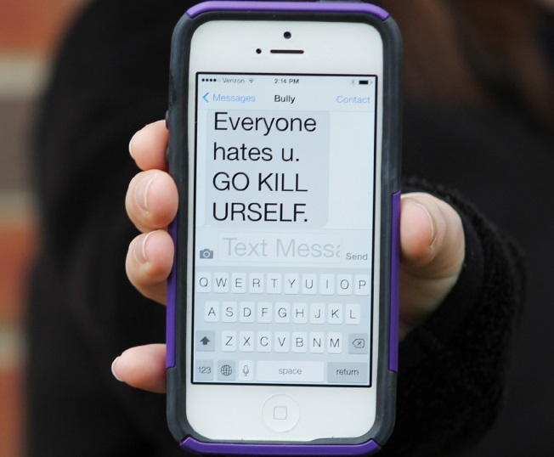
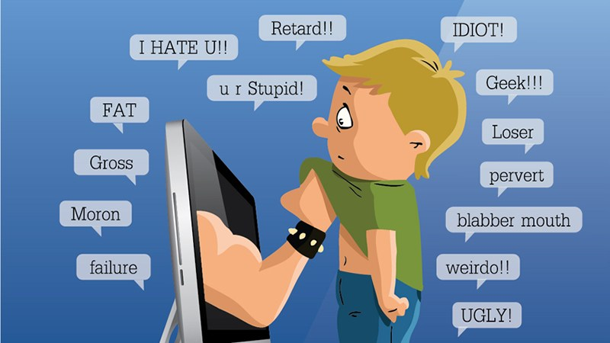
Introduction
What is cyberbullying?
Bullying
Harassment over social media
Proposed solutions
Slide 1 of 6

Slide 3



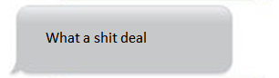
You’re
Trash
Personal pronoun used when directly addressing people
An offensive word when combined with personal pronouns creates a cyberbullying sample
Slide 2 of 6

Slide 4
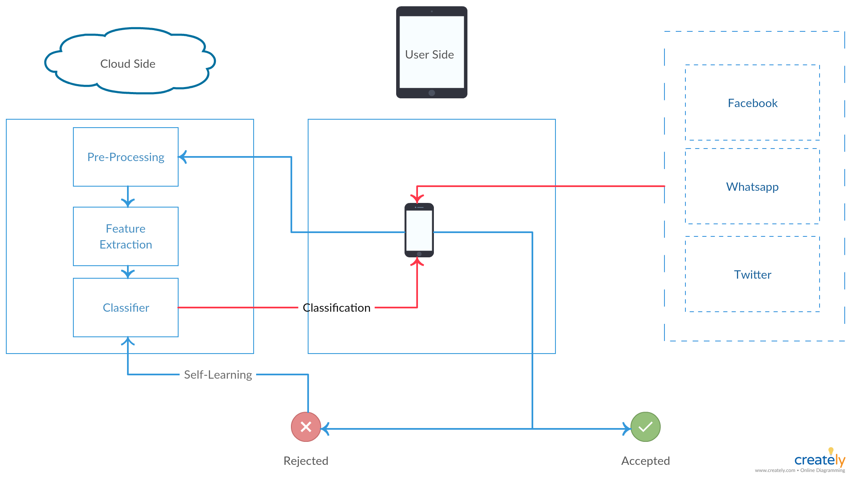



Business Model
Slide 3 of 6

Slide 5
Market motivation
Slide 4 of 6

Slide 6
Demo
Slide 5 of 6

Slide 7
Any Questions ?
Slide 6 of 6

Slide 8
Appendix

Slide 9
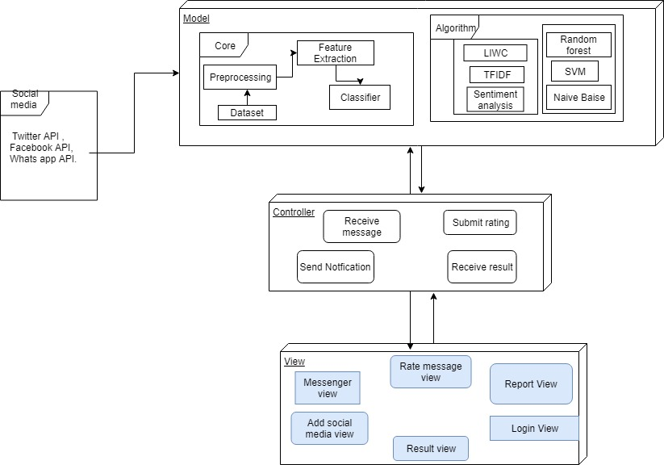
System Architecture
Feature
Extraction
Classifiers

Slide 10
Most Important Algorithm
Sentiment Analysis
What is Sentiment Analysis ?
Why we chose it ?
How it works ?

Slide 11
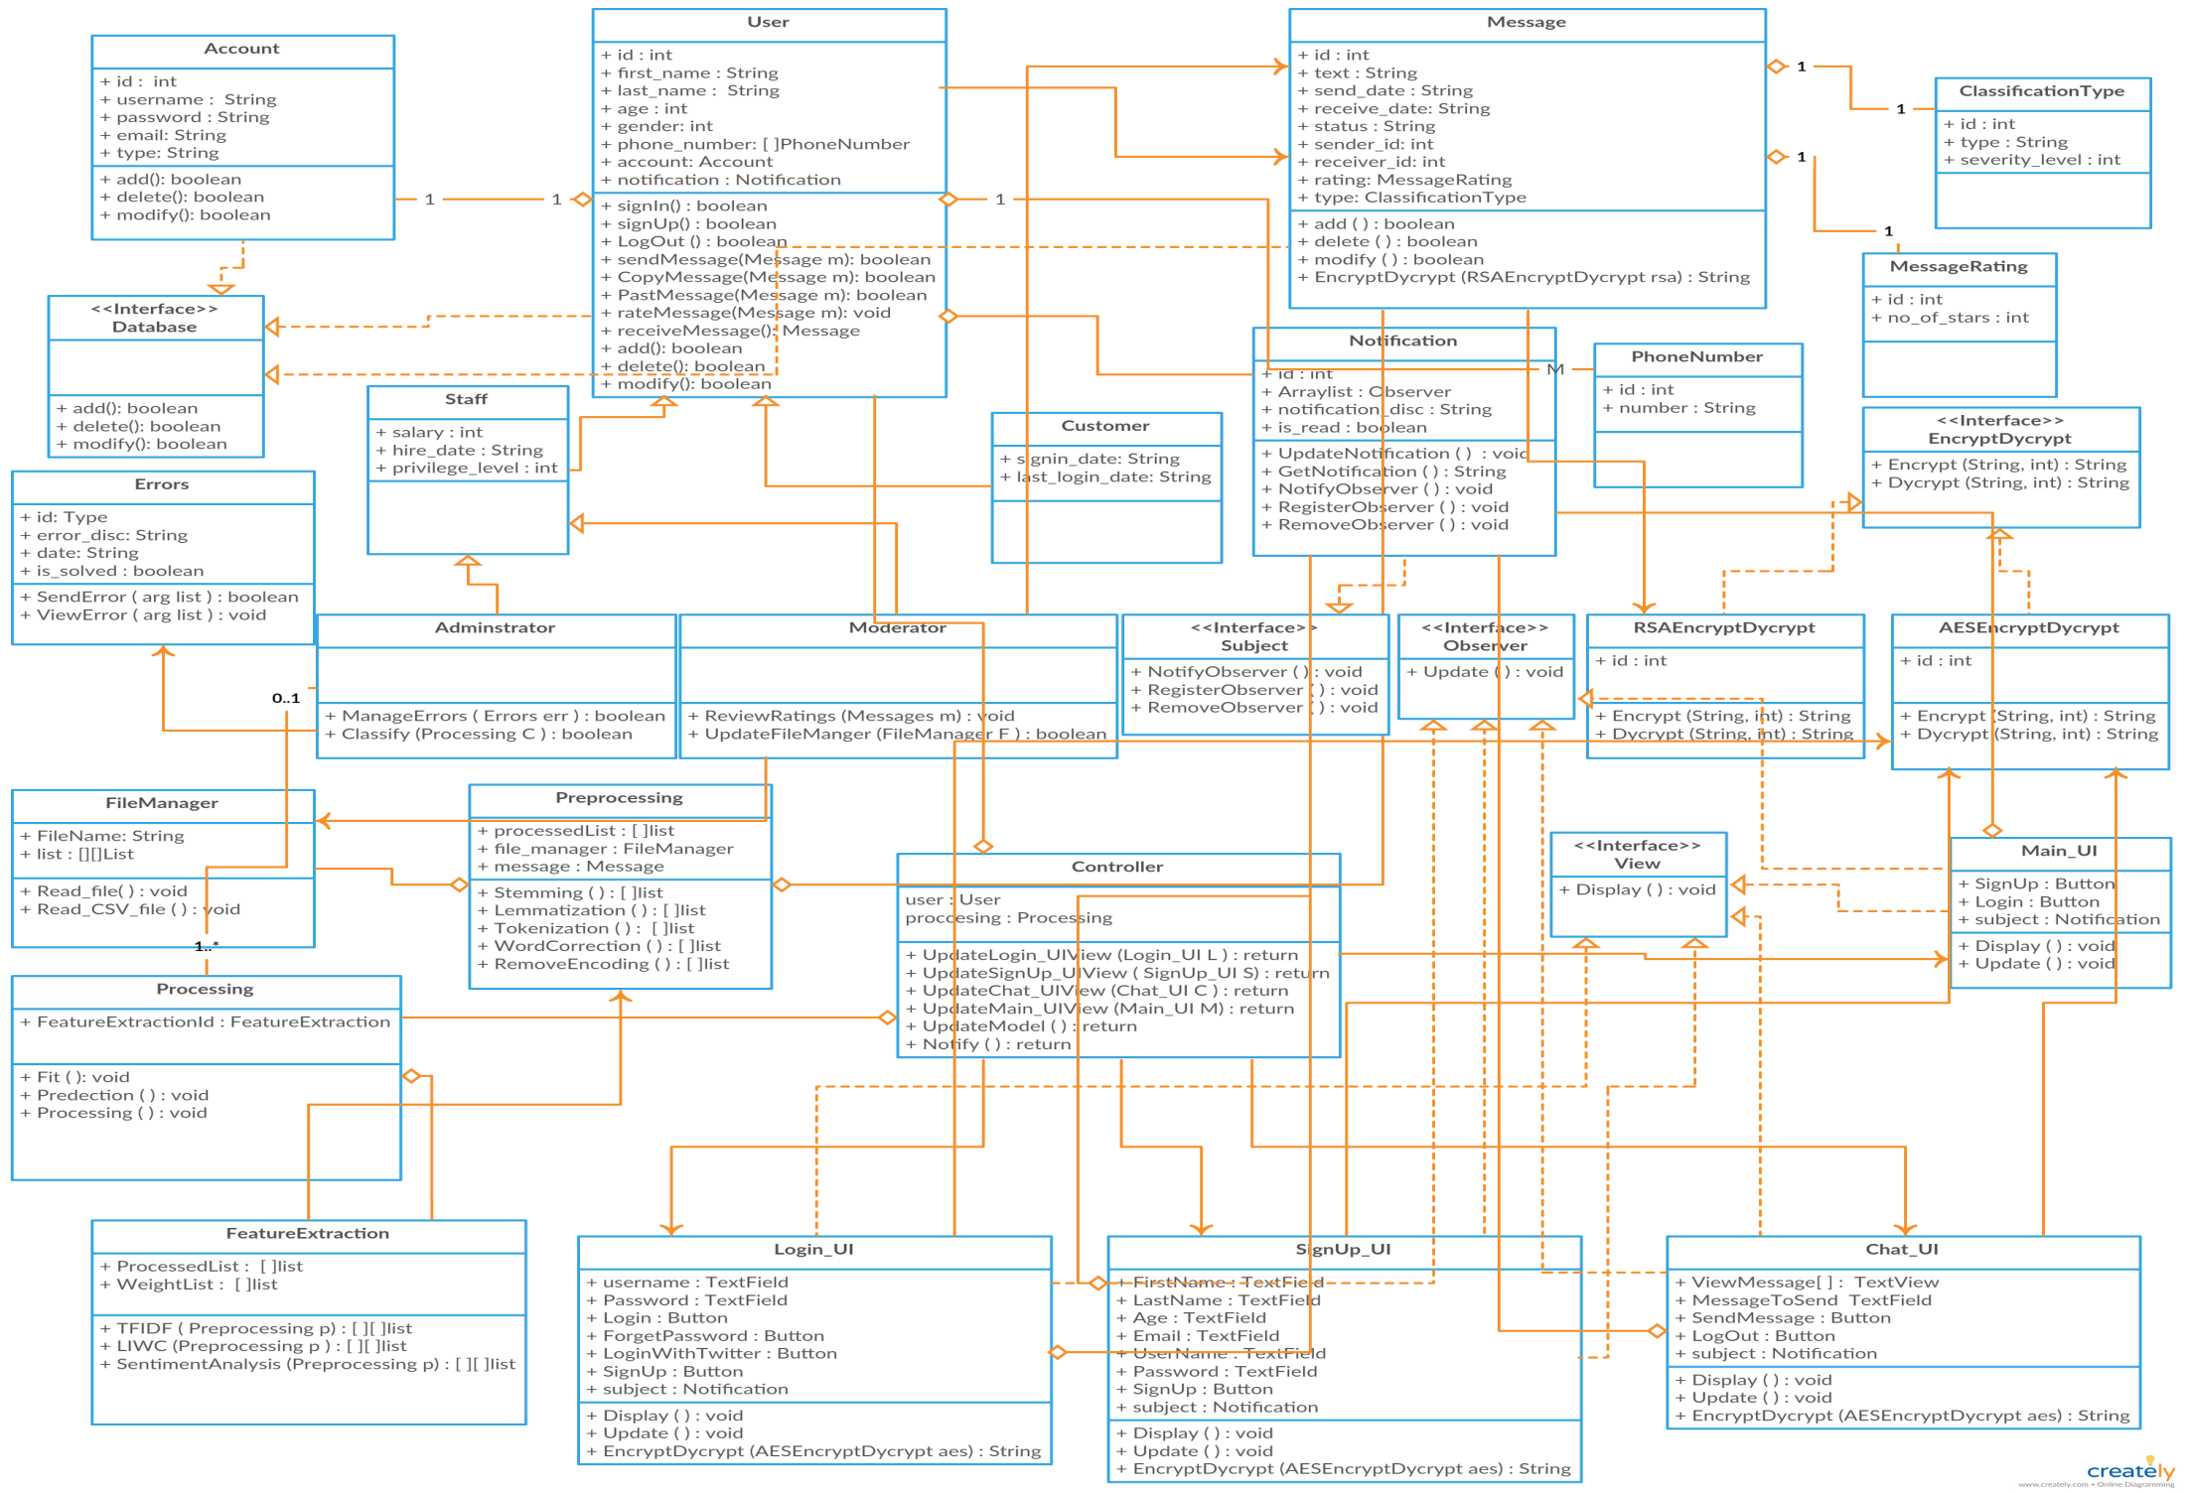
Class Diagram

Slide 12



Non Functional Requirements
Security
Maintainability
Portability
Have Encryption and Decryption
Self Learning
Both Desktop and Android

Slide 13
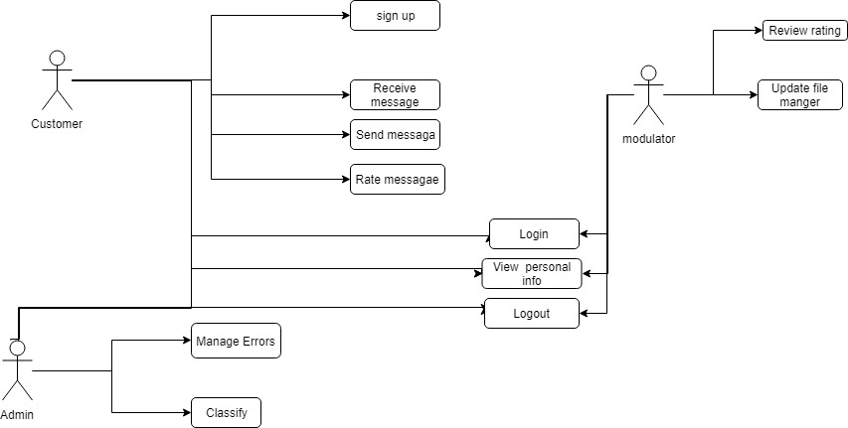
USE Case

Slide 14
Functional Requirement
User | Login with social media Rating
Messages | Send messages & Receive messages Encrypt & Decrypt
Processing | Preprocessing Feature extraction Classification
System | Notify Result Upgrade Classifier

Slide 15
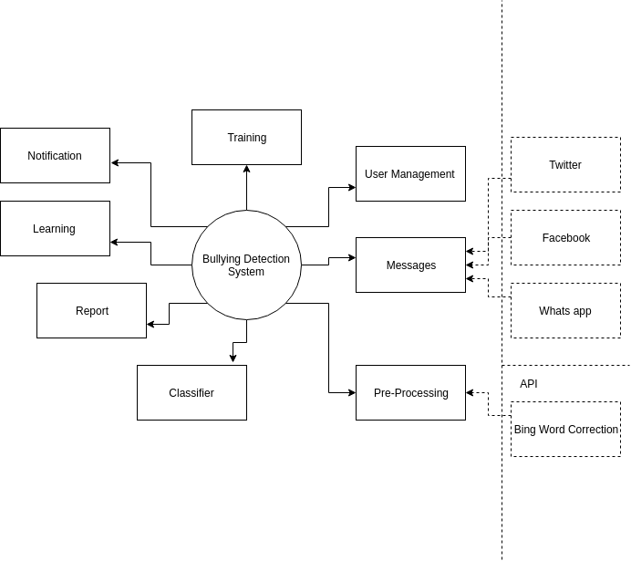
Context Diagram

Slide 16
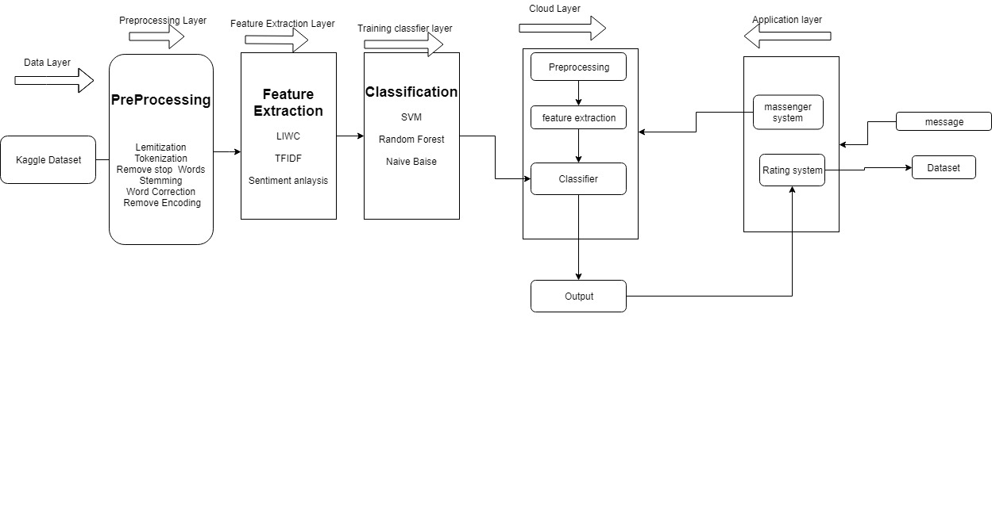
Block diagram

Slide 17
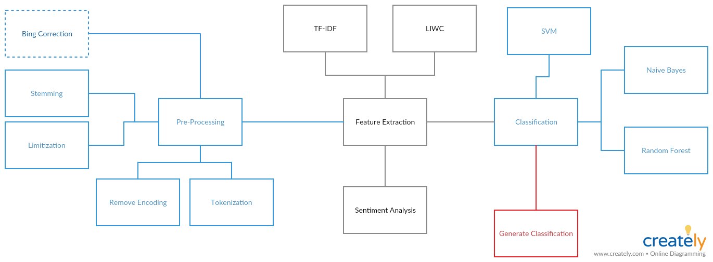
Block diagram

Slide 18
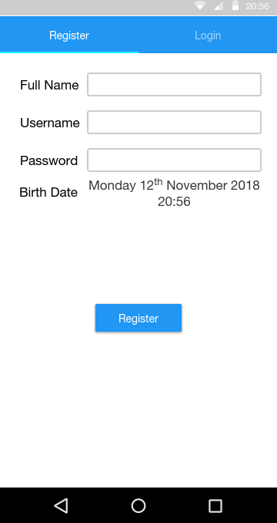
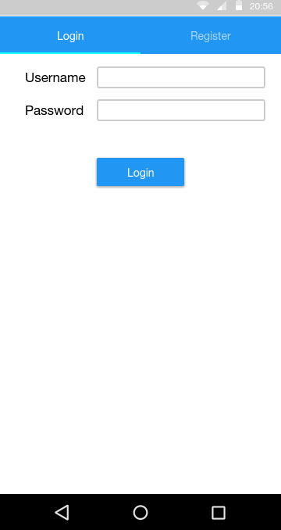
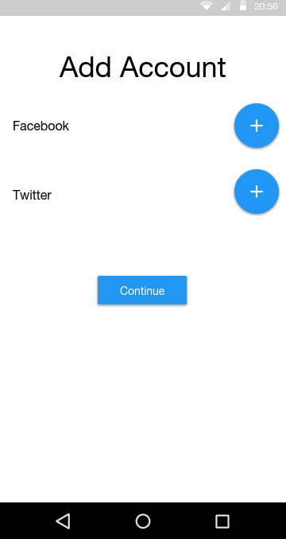
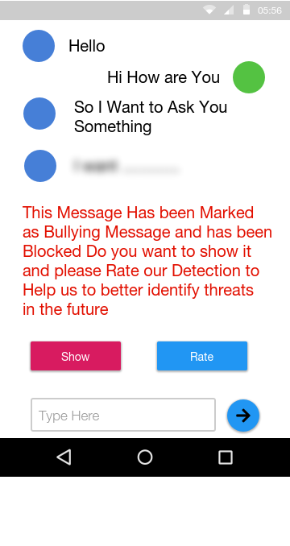
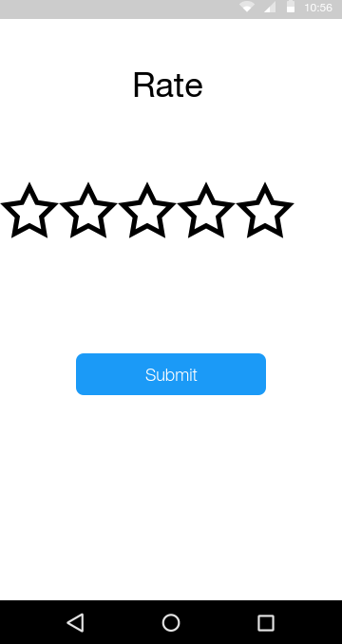
GUI

